Slide 1
Connected Vehicles: Solutions and Challenges. Conversations with Connected Vehicles
Ning Lu, Nan Cheng & Ning Zhang, Student Members, IEEE, Xuemin Shen, Fellow, IEEE, and Jon W. Mark, Life Fellow, IEEE
Simon Mayer. Department of Computer Science, ETH Zurich & Josh Siegel. Field Intelligence Laboratory, MIT.
Anusha Swarup, ECE Graduate Student & Medini J. Aradhya, ECE Graduate Student.

Slide 2
Introduction to what is discussed :
Systems that allow drivers and fleet managers to interact with connected vehicles.
Move data from vehicles to a remote server, established by an open vehicle telematics platform called CloudThink.
3 Main Objectives : a) Allow user interaction with vehicles using object recognition methods and generate user interfaces. b) How functional semantic data can be used to smooth boundaries between virtual and physical world. c) A method for monitoring user interactions to increase safety and security.

Slide 3
Motivation
Vehicles are one of the most frequently interacted with objects outside homes/ offices. Hence Web enabling vehicles will offer an opportunity to increase quality of life.
Potential to conserve and optimize the fuel and time spent commuting.
Reducing transit costs.
Integration of automobiles with other transit systems- Improved connectivity.
Provide feedback to help in safety and security.
A comprehensive development strategy without the need for reporting.

Slide 4
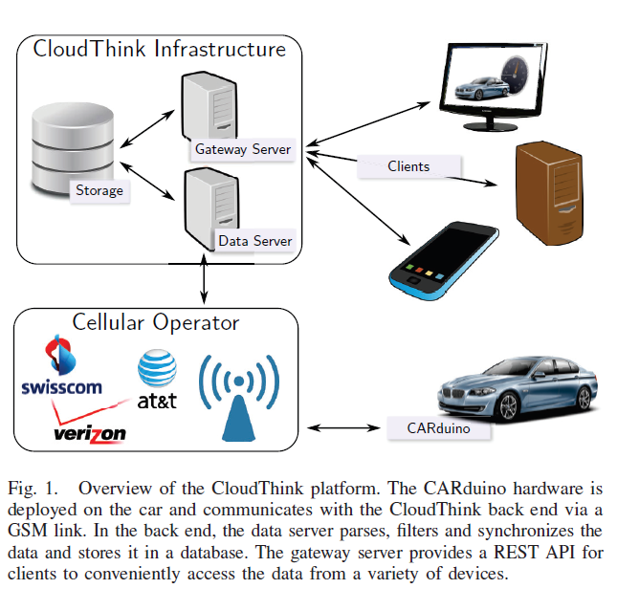
The CloudThink Platform
Vehicle to cloud communication platform
Consists of : A hardware platform called CARduino connected with OBD port that transmits the data over a GSM link.
A Data Server stores data uploaded from each car in a local database and the Gateway server allows third parties to access the data in a uniform way via a REST API.

Slide 5
Use cases for CloudThink
This platform is Agnostic of the concrete type and make of the vehicle. Enabling data sharing across boundaries of car manufacturers.
Virtual Vehicle leash – tracking stolen vehicles.
Reducing environmental Impact by providing ways to economize fuel.
Improving safety standards by providing feedback to drivers.
This platform could also be used to help drivers monetize their driving data. Eg: sharing usage statistics with the manufacturer to help improve vehicle characteristics
Help improve road quality/ maintenance with the help of real time feedback.

Slide 6
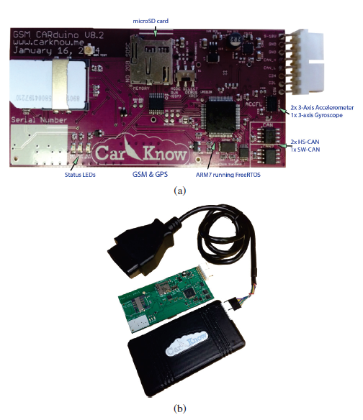
CARduino Hardware
Responsible for transmitting information from vehicle to CloudThink back end infrastructure where data is stored in an SQL database
All messages sent via GSM link are encoded to minimize volume of transmitted data
Each message sent consists of a recording timestamp, type of data, the data and a checksum to ensure accurate data capture.
CARduino has an onboard Accelerometer and GPS receiver configured to listen to the cars OBD-II interface.
On board memory unit, to buffer and transmit data.

Slide 7
Back-end Infrastructure
Vehicle information is processed by a synchronization script aligning all data points to a common 5 second time windows using linear interpolation
The script is also responsible for calculating several metrices : Fuel Consumption, distance driven etc.
The gateway server also provides client applications access to the synchronized data via a secure REST interface.
Secondly, the gateway server enables clients to send actuation commands to vehicles.
Finally, the gateway server enforces security by only allowing authorized users access to the data.

Slide 8
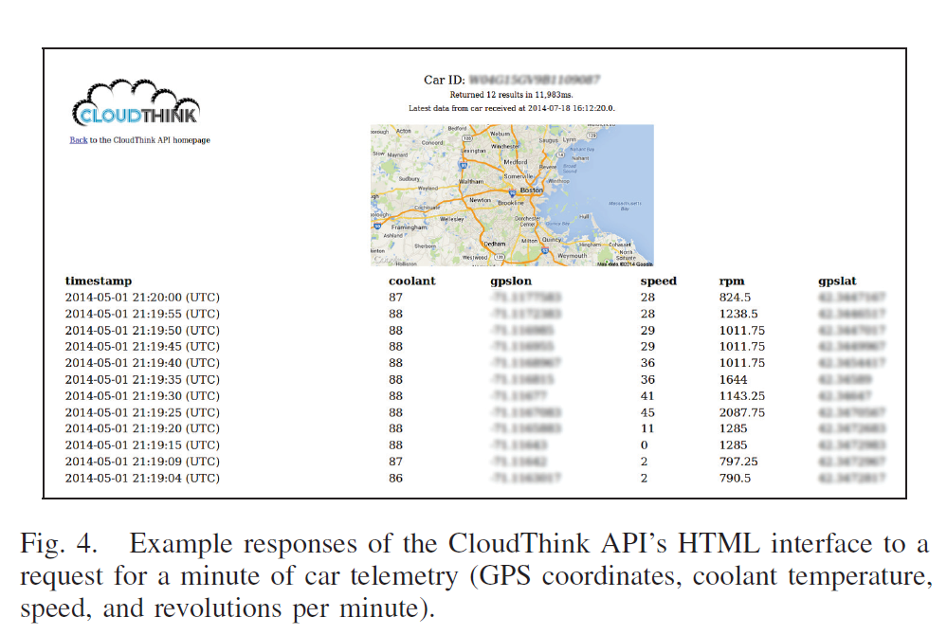

Slide 9
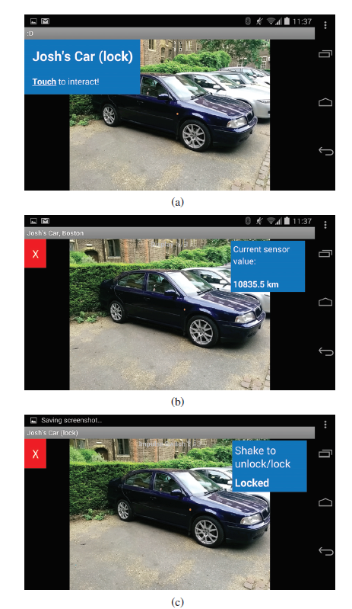
Direct User Interaction with a vehicle.
Devised a model to enable people to interact with a vehicle via a user interface (hand held or wearable devices) generated based on a visual object recognition algorithm.
Approach used in this paper combines Bag of visual words(BoW) with linear SVMs and FAST/ORB feature detection algorithm.
Hence doesn’t reply on fiducial markers and the system is trained on only snapshots of the cars.

Slide 10
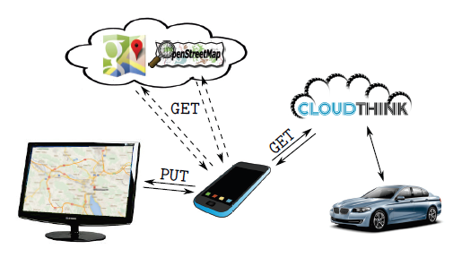
Functional Semantic Metadata for Smart Vehicles
Functional semantic metadata is used to capture the functionality of the CouldThink API by providing access to vehicle data individually identified by a VIN ( vehicle Identification No.)
Eg: Integration with Google Maps or OpenStreetMaps with the data from the API is used to provide location/tracking information.

Slide 11
Monitoring Car Interactions
Need:
Monitoring car interaction with the web of things is increasingly important in terms of security as to what information leaves/ enters the car.
Who has access to the actuation controls of the vehicles.
To prevent loss of information or wrong interpretation of the data available specific to a car type/ model .
Misuse of private data by authorities
Solution adopted :
Integrated software that logs all HTTP requests and responses with CloudThink backend and makes this data available to users in real time.

Slide 12
Limitations
Lack of security measures on actuation protocols. ( Eg: door lock/open etc.)
Heavily dependent on Current lighting conditions for object recognition.
Visual Similarity of distinct vehicles not taken into consideration.
Even though CARduino has a buffer, loss of GSM signal may mean loss of information temporarily in critical situations.

Slide 13
Future Scope
Expanding the API to allow return interaction
Incorporating lighting conditions into the visual object recognition algorithm.
Enabling 3rd party application builders to modify firmware behavior on the CARduino within controlled boundaries keeping in mind the risk of malicious code execution to protect sensitive data.

